Slide 1

ATI Stream Computing
ATI Radeon™ HD 2900 Series Instruction Set Architecture
Micah Villmow
May 30, 2008

Slide 2
ATI Radeon™ HD 2900 Series GPU ISA
Useful Definitions
Why learn ISA?
Control Flow Programs – What are they?
Clauses – Atomicity Guaranteed
  ALU Clauses
  TEX Clauses
  VTX Clauses
Instructions – Understanding them

Slide 3
Definitions
CF – Control Flow
Clause temps – GPR124-127 that are temporary registers, also refered to as T#
kcache – on-chip constant memory that can be locked
Clause – homogonous group of instructions run atomically on the hardware, either ALU, TEX, or VTX
Quad – Four (x,y) data elements arranged in a 2-by-2 array
Fetch – Load data via the vertex or texture instructions
Predicate – A bit that is set/cleared as result of a condition that masks writing to an ALU result
PV – Previous Vector, get vector unit (XYZW) results from previous ALU clause
PS – Previous Scalar, get trans unit (T) result from previous ALU clause

Slide 4
Whole Quad Mode vs. Valid Pix
Whole Quad Mode(WQM)
Executes clause as if all pixels are alive.
Valid Pixel Mode(VPM)
Executes only live pixels
0
1
0
1
All pixels valid
All pixels valid
2
3
2
3
0
1
0
1
Kill Pixel 1
Kill Pixel 1
2
3
2
3
0
1
Execute ALU w/
WQM flag brings
pixel 1 back
temporarily
0
1
Execute ALU w/
VPM flag ignores
pixel 1
2
3
2
3

Slide 5
Why Learn ISA?
Write this
AMD HLSL
GPU ISA
Understand this
const CALchar* HLSLKernel =
"cbuffer myConstants\n"
"{ float4 inc;float4 repeat;};\n"
"void main( in float4 wpos:VPOS,
out float4 out0 : SV_TARGET )\n"
"{\n"
" out0 = inc.wzyx; \n"
" for( ; repeat.x>0.01f;
repeat.x=repeat.x-1.f){\n"
" out0 = out0 + inc; \n"
" }}\n"
;PS; -------- Disassembly --------------------
00 ALU: ADDR(32) CNT(8) KCACHE0(CB0:0-15)
0 x: MOV R0.x, KC0[1].x
y: MOV R1.y, KC0[1].y
z: MOV R1.z, KC0[1].z
w: MOV R1.w, KC0[1].w
1 x: MOV R1.x, KC0[0].w
y: MOV R1.y, KC0[0].z
z: MOV R1.z, KC0[0].y
w: MOV R1.w, KC0[0].x
01 LOOP_DX10 i0 FAIL_JUMP_ADDR(5) VALID_PIX
02 ALU_BREAK: ADDR(40) CNT(3)
2 x: SETGT_DX10 R2.x, R0.x, 0x3C23D70A
3 x: PREDNE_INT ____, R2.x, 0.0f
03 ALU: ADDR(43) CNT(5) KCACHE0(CB0:0-15)
4 x: ADD R1.x, KC0[0].x, R1.x
y: ADD R1.y, KC0[0].y, R1.y
z: ADD R1.z, KC0[0].z, R1.z
w: ADD R1.w, KC0[0].w, R1.w
t: ADD R0.x, R0.x, -1.0f
04 ENDLOOP i0 PASS_JUMP_ADDR(2)
05 EXP_DONE: PIX0, R1
END_OF_PROGRAM
CALobject obj
calutAMDhlslCompileProgram(&obj,
CAL_PROGRAM_TYPE_PS,
HLSLKernel,
CAL_TARGET_670 )
Help to understand what is actually being executed
Allow exact calculation of theoretical peaks
Determine bottlenecks in code
Help to optimize code by analyzing generated code

Slide 6
Control Flow Programs
Series of Control Flow instructions which can:
  Initiate execution of clauses
  Allocate space in input or output buffer
  Export to or import from a data buffer
  Control branching, looping, and stack operations
  40 cycle latency that needs to be hidden
GPU ISA
;PS; -------- Disassembly --------------------
00 ALU: ADDR(32) CNT(8) KCACHE0(CB0:0-15)
0 x: MOV R0.x, KC0[1].x
y: MOV R1.y, KC0[1].y
z: MOV R1.z, KC0[1].z
w: MOV R1.w, KC0[1].w
1 x: MOV R1.x, KC0[0].w
y: MOV R1.y, KC0[0].z
z: MOV R1.z, KC0[0].y
w: MOV R1.w, KC0[0].x
01 LOOP_DX10 i0 FAIL_JUMP_ADDR(5) VALID_PIX
02 ALU_BREAK: ADDR(40) CNT(3)
2 x: SETGT_DX10 R2.x, R0.x, 0x3C23D70A
3 x: PREDNE_INT ____, R2.x, 0.0f
03 ALU: ADDR(43) CNT(5) KCACHE0(CB0:0-15)
4 x: ADD R1.x, KC0[0].x, R1.x
y: ADD R1.y, KC0[0].y, R1.y
z: ADD R1.z, KC0[0].z, R1.z
w: ADD R1.w, KC0[0].w, R1.w
t: ADD R0.x, R0.x, -1.0f
04 ENDLOOP i0 PASS_JUMP_ADDR(2)
05 EXP_DONE: PIX0, R1
END_OF_PROGRAM
Control Flow
Instructions

Slide 7
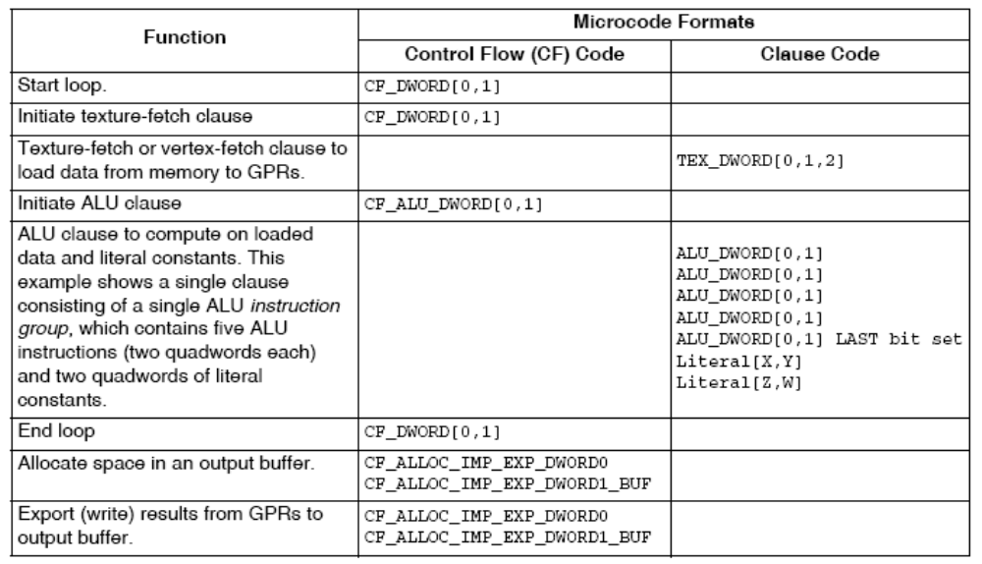
Typical CF Program Flow

Slide 8
Control Flow Clauses – ALU/TEX
ALU CF Clause – 1 to 128 ALU slots, where max of 5 ALU slots per ALU clause.
03 ALU: ADDR(43) CNT(5) KCACHE0(CB0:0-15)
4 x: ADD R1.x, KC0[0].x, R1.x
y: ADD R1.y, KC0[0].y, R1.y
z: ADD R1.z, KC0[0].z, R1.z
w: ADD R1.w, KC0[0].w, R1.w
t: ADD R0.x, R0.x, -1.0f
TEX CF Clause – 1 to 8 TEX slots per clause
03 TEX: ADDR(176) CNT(8) VALID_PIX
9 SAMPLE R0, R18.wxww, t4, s4 UNNORM(XYZW)
10 SAMPLE R5, R18.wyww, t0, s0 UNNORM(XYZW)
11 SAMPLE R6, R18.wyww, t1, s1 UNNORM(XYZW)
12 SAMPLE R7, R18.wyww, t2, s2 UNNORM(XYZW)
13 SAMPLE R8, R18.wyww, t3, s3 UNNORM(XYZW)
14 SAMPLE R1, R18.wxww, t5, s5 UNNORM(XYZW)
15 SAMPLE R3, R18.wxww, t6, s6 UNNORM(XYZW)
16 SAMPLE R9, R18.wxww, t7, s7 UNNORM(XYZW)

Slide 9
Control Flow Clauses – VTX/VTX_TC
VTX CF Clause – 1 to 8 VTX slots per clause
00 VTX: ADDR(176) CNT(2)
0 VFETCH R1.xy__, R0.x, fc128 MEGA(16) OFFSET(0) FETCH_TYPE(NO_INDEX_OFFSET)
2 VFETCH R2.xy__, R0.x, fc128 MEGA(16) OFFSET(0) FETCH_TYPE(NO_INDEX_OFFSET)
VTX_TC CF Clause – same as VTX, but through texture cache
used when vertex unit does not exist on chip
00 VTX_TC: ADDR(176) CNT(2)
0 VFETCH R1.xy__, R0.x, fc128 MEGA(16) OFFSET(0) FETCH_TYPE(NO_INDEX_OFFSET)
2 VFETCH R2.xy__, R0.x, fc128 MEGA(16) OFFSET(0) FETCH_TYPE(NO_INDEX_OFFSET)

Slide 10
Control Flow Clauses – Color/Scratch
EXP_DONE – Sends data out via the pixel buffer, or color buffer, and signals no more exports will occur
05 EXP_DONE: PIX0, R1 // write to R1 to o0 only
or
01 EXP_DONE: PIX0, R1 BRSTCNT(7) // Write to R1-R8 to o0-o7
Scratch Write – Write to a scratch buffer
HD38XX:
03 MEM_SCRATCH_READ_IND: R3, VEC_PTR[0+R3.x], ARRAY_SIZE(1) ELEM_SIZE(3)
HD48XX:
04 VTX: ADDR(48) CNT(2)
4 MEM_SCRATCH_READ_VF R3, VEC_PTR[0+R3.x], ARRAY_SIZE(1) ELEM_SIZE(3)
UNCACHED BURST_CNT(0)
Scratch Read – Read from a scratch buffer
HD38XX:
01 MEM_SCRATCH_WRITE_IND: VEC_PTR[0+R0.x], R1, ARRAY_SIZE(1) ELEM_SIZE(3) BURST_CNT(0)
HD48XX:
2 MEM_SCRATCH_WRITE_IND_ACK: VEC_PTR[0+R2.x], R1, ARRAY_SIZE(1) ELEM_SIZE(3) BURST_CNT(0)

Slide 11
Control Flow Clauses – Global Buffer
Gather Clause – Read from Global Memory Buffer
HD38XX:
01 MEM_GLOBAL_READ_IND: R0, DWORD_PTR[0+R0.x], ELEM_SIZE(3)
HD48XX:
01 VTX: ADDR(48) CNT(1)
4 MEM_SCATTER_READ_VF R0, DWORD_PTR[0+R0.x], ELEM_SIZE(3) UNCACHED BURST_CNT(0)
Scatter Clause – Write to Global Memory Buffer
HD38XX:
01 MEM_GLOBAL_WRITE_IND: DWORD_PTR[0+R1.x], R0, ELEM_SIZE(3) or
HD48XX:
01 MEM_GLOBAL_WRITE_IND_ACK: DWORD_PTR[0+R1.x], R0, ELEM_SIZE(3)

Slide 12
Control Flow Clauses - Conditionals
ALU_BREAK: Breaks out of a loop based on predicate set in instruction in the clause
02 ALU_BREAK: ADDR(37) CNT(2) KCACHE0(CB0:0-15)
1 y: SETE_INT R0.y, R0.x, KC0[1].x
2 x: PREDE_INT ____, R0.y, 0.0f UPDATE_EXEC_MASK UPDATE_PRED
Other instructions, if, else, endloop etc…
Jump(i.e. If):
01 JUMP ADDR(5) VALID_PIX
Else:
05 ELSE POP_CNT(1) ADDR(22) VALID_PIX
Push Stack:
12 ALU_PUSH_BEFORE: ADDR(50) CNT(3)
Pop Stack:
44 ALU_POP_AFTER: ADDR(122) CNT(1)
Whileloop:
01 LOOP_DX10 i0 FAIL_JUMP_ADDR(5) VALID_PIX
Endloop:
04 ENDLOOP i0 PASS_JUMP_ADDR(2)

Slide 13
ALU Clauses – ALU Overview
03 ALU: ADDR(43) CNT(5) KCACHE0(CB0:0-15)
4 x: ADD R1.x, KC0[0].x, R1.x
y: ADD R1.y, KC0[0].y, R1.y
z: ADD R1.z, KC0[0].z, R1.z
w: ADD R1.w, KC0[0].w, R1.w
t: ADD R0.x, R0.x, -1.0f
LSB
X
LSB
X
Y
Y
KC0[0]
MSB
LSB
R1
R1
128 bits
W
Z
Y
X
Z
Z
128 bits
32 bits
32 bits
W
W
MSB
MSB
128 bits
R0.x
R0.x
-1.0f
T
T
T

Slide 14
ALU Clauses – GPRs
127 GPR’s per thread accessible, via R register
256 constants per thread, via C register
GPR [124,127] are temps that last through ALU CF clause, via T register
PV/PS are temps that last 1 ALU clause
SR – Shared global registers
AR – Address register allows dynamic indexing into register file, only via MOVA instruction
aL – Index loop register for loop based offsets
KC0/1 – Constant cache bank 01 register
Read port and cycle Restrictions!

Slide 15
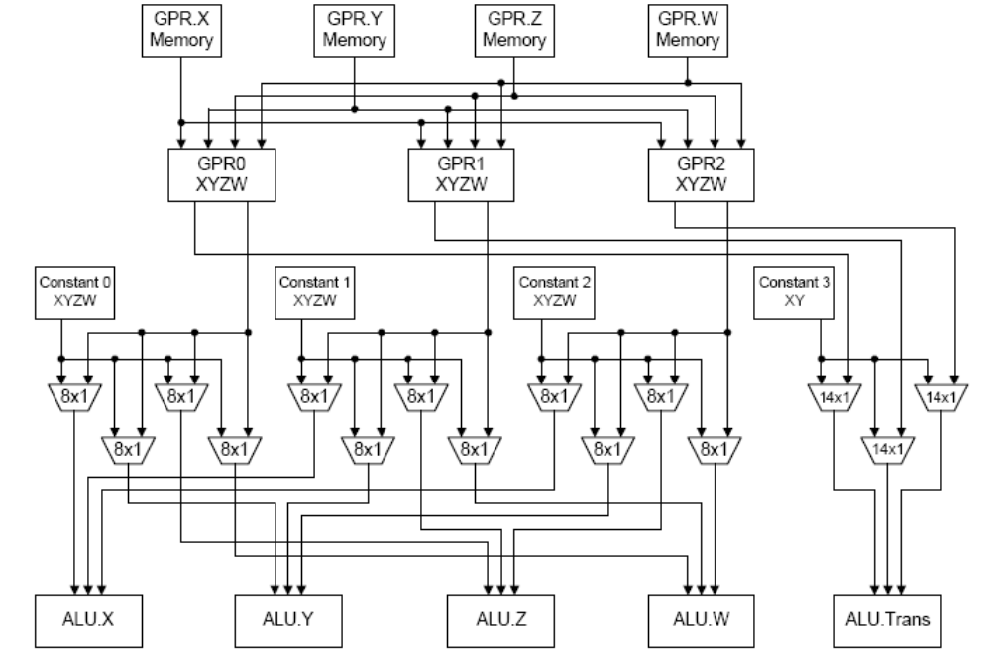
ALU Clause - ALU Data Flow
GPR Read port restrictions – only 3 different GPR’s are accessible per ALU clause
Constant Read Port Restrictions – Only 4 distinct elements can be read per ALU clause

Slide 16
ALU Clauses – Misc
4 x: ADD R1.x, R31.y, (0xC0400000, -3.0f).x
y: MULADD T0.y, -PV3.y, (0x41000000, 8.0f).y, T1.z
z: ADD R2.z, T0.x, R29.z
w: MULADD T0.w, -PV3.z, (0x41000000, 8.0f).y, T0.z VEC_120
t: ADD R2.w, R16.w, R31.y
Cycle restrictions cause issues when reading from T/R/SR registers.
The src registers are read over three cycles.
Src0 = cycle 0, src1 = cycle 1, src2 = cycle 2
VEC_### changes the cycle the read would occur at because of port restrictions
02 ALU: ADDR(39) CNT(2)
3 x: MOV SR0.x, R0.x
4 x: MOV R1.x, SR0.x
Notes:
Don’t forget the SR at the end

Slide 17
TEX/VTX Clauses
03 TEX: ADDR(18748) CNT(4) VALID_PIX
20 SAMPLE R2, R2.zwzz, t1, s1 UNNORM(XYZW)
21 SAMPLE R6, R0.zyzz, t1, s1 UNNORM(XYZW)
22 SAMPLE R8, R3.zwzz, t1, s1 UNNORM(XYZW)
23 SAMPLE R32, R29.zwzz, t1, s1 UNNORM(XYZW)
01 TEX: ADDR(112) CNT(5)
16 LDS_READ R0, R0.zy WATERFALL
01 TEX: ADDR(48) CNT(1)
1 LDS_WRITE (0) R0.xyyy, STRIDE(16) SIMD_REL
02 TEX: ADDR(48) CNT(1)
2 LDS_WRITE (0) R1.xyyy, STRIDE(16) SIMD_ABS
03 TEX: ADDR(48) CNT(1)
3 LDS_WRITE (0) R2.xyyy, STRIDE(16) SIMD_REL FFT_PERMUTE
01 VTX: ADDR(48) CNT(1)
4 MEM_SCATTER_READ_VF R0, DWORD_PTR[0+R0.x], ELEM_SIZE(3) UNCACHED BURST_CNT(0)
00 VTX: ADDR(176) CNT(2)
0 VFETCH R1.xy__, R0.x, fc128 MEGA(16) OFFSET(0) FETCH_TYPE(NO_INDEX_OFFSET)
04 VTX: ADDR(48) CNT(2)
4 MEM_SCRATCH_READ_VF R3, VEC_PTR[0+R3.x], ARRAY_SIZE(1) ELEM_SIZE(3)
UNCACHED BURST_CNT(0)

Slide 18
Disclaimer & Attribution
DISCLAIMER
The information presented in this document is for informational purposes only and may contain technical inaccuracies, omissions and typographical errors.
The information contained herein is subject to change and may be rendered inaccurate for many reasons, including but not limited to product and roadmap changes, component and motherboard version changes, new model and/or product releases, product differences between differing manufacturers, software changes, BIOS flashes, firmware upgrades, or the like. AMD assumes no obligation to update or otherwise correct or revise this information. However, AMD reserves the right to revise this information and to make changes from time to time to the content hereof without obligation of AMD to notify any person of such revisions or changes.
AMD MAKES NO REPRESENTATIONS OR WARRANTIES WITH RESPECT TO THE CONTENTS HEREOF AND ASSUMES NO RESPONSIBILITY FOR ANY INACCURACIES, ERRORS OR OMISSIONS THAT MAY APPEAR IN THIS INFORMATION.
AMD SPECIFICALLY DISCLAIMS ANY IMPLIED WARRANTIES OF MERCHANTABILITY OR FITNESS FOR ANY PARTICULAR PURPOSE. IN NO EVENT WILL AMD BE LIABLE TO ANY PERSON FOR ANY DIRECT, INDIRECT, SPECIAL OR OTHER CONSEQUENTIAL DAMAGES ARISING FROM THE USE OF ANY INFORMATION CONTAINED HEREIN, EVEN IF AMD IS EXPRESSLY ADVISED OF THE POSSIBILITY OF SUCH DAMAGES.
ATTRIBUTION
© 2010 Advanced Micro Devices, Inc. All rights reserved. AMD, the AMD Arrow logo, ATI, the ATI Logo, Radeon, and combinations thereof are trademarks of Advanced Micro Devices, Inc. Other names are for informational purposes only and may be trademarks of their respective owners.

